Slide 1
Technical Skills Challenge
Week 2: Asking Questions about questions about questions about questions about quest

Slide 2
Before We start...

Slide 3
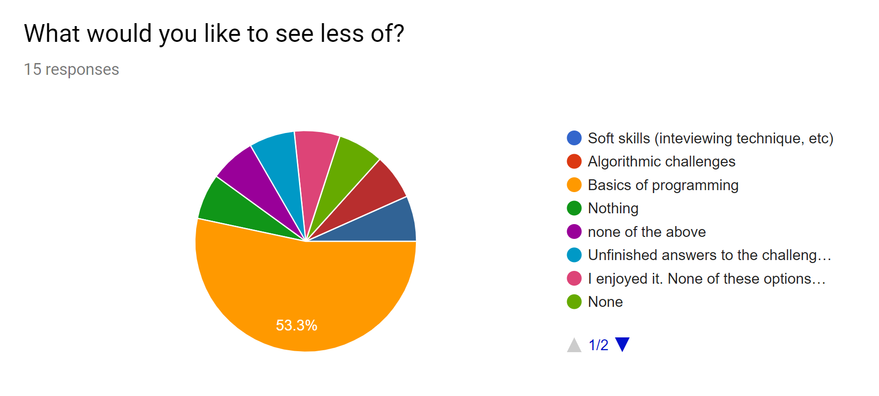
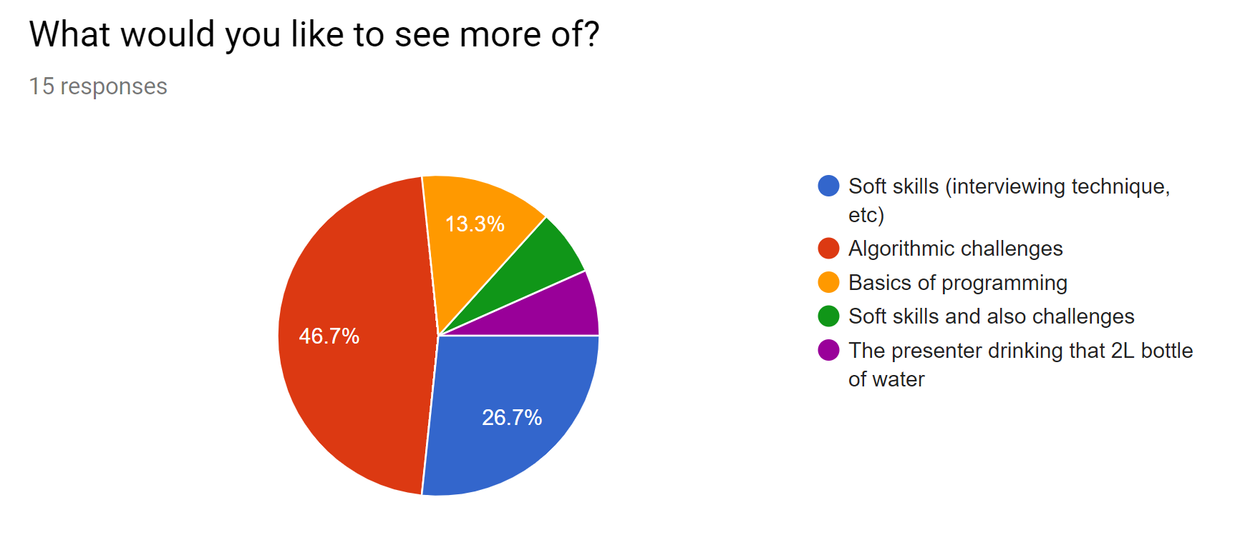
Thanks for your feedback!
Here’s what people told us...

Slide 4
Thanks for your feedback!
Here’s what people told us...

Slide 5
Thanks for your feedback!
What went well…
The friendly, non-judgmental atmosphere
Working on stuff together
Granular, easy to understand explanation of concepts
But we could improve on…
Having harder questions as well for people with a bit more experience
Being a bit better prepared!
And people wanted to see us cover technical skills outside of algorithm stuff.

Slide 6
So what are we doing in response?
We’re going to do this bi-weekly instead of weekly
(Next session will be the 30th of October, the night before Halloween. Spooky 👻).
That’ll give us more time to prepare this well around our jobs and courses.
We’re trying out a new format that should make it easier to prepare without compromising on the usefulness, and have made some internal efficiency changes. We’ll be able to include new Committee Members in the process.
There is a take home question which is a little more challenging, and an example of a google interview question in the github repo for a real challenge.
If we are finding we’re able to reasonably prepare this bi-weekly, we’re going to look into running wider ranging technical/employability workshops on the unfilled Tuesdays (how to use git, basic tools, clean code principles, having a good LinkedIn profile, etc.).

Slide 7
Question 1: A Step Above the Rest

Slide 8
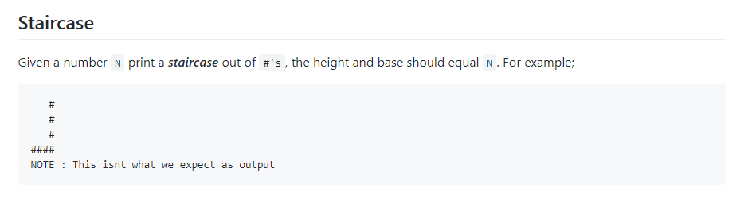
The question as asked...

Slide 9
What Questions Would you Ask?
Print a staircase of base N and height N
E.g.
#
##
###
####
(2 minutes)
Things to think about:
Is anything unclear?
Are there any edge cases that aren’t fully addressed?
What data do you need?
What qualifies a correct answer?
Do you need to think about extensibility?
What format should the returned data be in?
Does your answer need to work for big inputs?
What DO you expect as output? [ABOVE]
Does the staircase have to face left? [YES]
Is my font going to be uniform width? [YES]
Does it have to be lined up like that? [YES]
Does it have to have the largest at the bottom? [YES]
Will it always step in by 1 hash? [YES]
Does this string need to be stored or can it be printed? [PRINTED IS FINE]

Slide 10
How would you start answering this?
Print a staircase of base N and height N
E.g.
#
##
###
####
(3 minutes)
Things to think about:
Do any problems/quick solutions jump out to you?
What are your first assumptions? Are they correct?
Are there any processes that are repeated?
What code structures could this use? (If/Else, Loops, Recursion…)
What datatypes are the input and output going to be? What format are they in?
We have a repeated process of a known size so a For loop is probably most appropriate
If this was going left to right this would be a slightly easier problem. How would we do that?
How do we know how many spaces to type?

Slide 11
Let’s write some pseudocode!
THINGS TO REMEMBER:
We should probably use a for loop
Our staircase needs to face left, not right
We can make use of printing to make this easier
IF YOU HAVE ANY MORE QUESTIONS, ASK!
Print a staircase of base N and height N
E.g.
#
##
###
####
(10 Minutes)
Things to think about:
Can you put any reused or difficult processes into their own functions so you can think about them separately?
Are you trying to calculate exactly what the question is asking for? If not, is there an easier way to get that answer?
Are there any edge cases that your algorithm doesn’t account for?

Slide 12
Now let’s write some real code!
THINGS TO REMEMBER:
We should probably use a for loop
Our staircase needs to face left, not right
We can make use of printing to make this easier
IF YOU HAVE ANY MORE QUESTIONS, ASK!
Print a staircase of base N and height N
E.g.
#
##
###
####
(10 Minutes)
If you’re not happy with your pseudocode yet, keep trying! Ask others at your table, too.
Things to think about:
Any plain english in your pseudocode can probably become the name of a function
You might have to go back to your pseudocode if things you didn’t think about crop up.

Slide 13
Time!

Slide 14
Anybody figure it out (or close to) in pseudocode?

Slide 15
Anybody get any interesting revelations?

Slide 16
Anybody get it working (or close to) in real code?

Slide 17
Anybody want to show theirs off?

Slide 18
Question 2: Destined Pairs

Slide 19
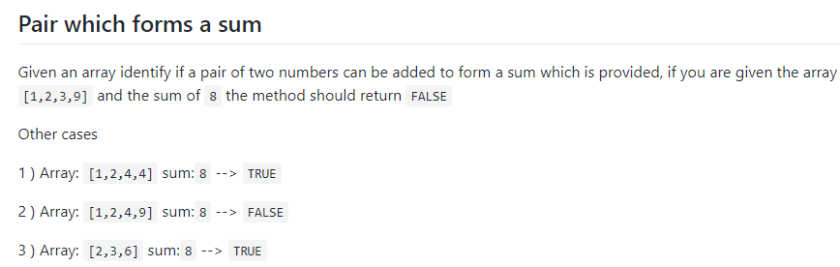
The question as asked...

Slide 20
What Questions Would you Ask?
The question as asked again
(2 minutes)
Things to think about:
Is anything unclear?
Are there any edge cases that aren’t fully addressed?
What data do you need?
What qualifies a correct answer?
Do you need to think about extensibility?
What format should the returned data be in?
Does your answer need to work for big inputs?
Do we need to account for decimals? [NO]
Do we need to account for negative numbers? [YEAH]
What if the number is already in the array? [NEEDS TO BE A PAIR]
Do we need to account for really large input arrays [PREFERABLY YEAH]
Does the order of the array matter? [YES!! YOU CAN ASSUME THE ARRAY IS SORTED]

Slide 21
How would you start answering this?
(3 minutes)
Things to think about:
Do any problems/quick solutions jump out to you?
What are your first assumptions? Are they correct?
Are there any processes that are repeated?
What code structures could this use? (If/Else, Loops, Recursion…)
What datatypes are the input and output going to be? What format are they in?
We can probably use a for loop to check each element of this array
How do we make sure we don’t add a number to itself?
Can we use the value of our last result to inform what we do next?

Slide 22
Let’s write some pseudocode!
THINGS TO REMEMBER:
The arrays are always in ascending order!!
We don’t need to return the pair, just True/False
Make sure you’re not counting the same number twice
You don’t need to worry about running across the number itself.
Can we use our last result to inform what we do next?
IF YOU HAVE ANY MORE QUESTIONS, ASK!
(15 Minutes)
Things to think about:
Can you put any reused or difficult processes into their own functions so you can think about them separately?
Are you trying to calculate exactly what the question is asking for? If not, is there an easier way to get that answer?
Are there any edge cases that your algorithm doesn’t account for?

Slide 23
Now let’s write some real code!
THINGS TO REMEMBER:
The arrays are always in ascending order!!
We don’t need to return the pair, just True/False
Make sure you’re not counting the same number twice
You don’t need to worry about running across the number itself.
Can we use our last result to inform what we do next?
IF YOU HAVE ANY MORE QUESTIONS, ASK!
(15 Minutes)
If you’re not happy with your pseudocode yet, keep trying! Ask others at your table, too.
Things to think about:
Any verbs in your pseudocode can probably indicate a comparison or function call, nouns could become variables. Full sentences could become functions names.
You might have to go back to your pseudocode if things you didn’t think about crop up.

Slide 24
Time!

Slide 25
Anybody figure it out (or close to) in pseudocode?

Slide 26
Anybody get any interesting revelations?

Slide 27
Anybody get it working (or close to) in real code?

Slide 28
Anybody want to show theirs off?

Slide 29
Finally, one to grow on...

Slide 30
Question 3: I am! The one and only!

Slide 31
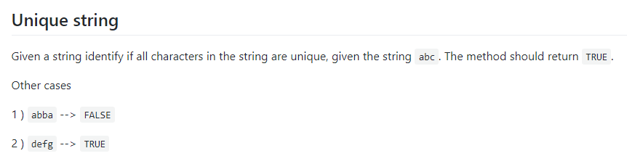
The question as asked...

Slide 32
What Questions Would you Ask?
(2 minutes)
Things to think about:
Is anything unclear?
Are there any edge cases that aren’t fully addressed?
What data do you need?
What qualifies a correct answer?
Do you need to think about extensibility?
What format should the returned data be in?
Does your answer need to work for big inputs?
Do you need to think about capital letters? [NO]
Do you need to account for punctuation? [NO]
Does it matter if they’re adjacent? [NO]

Slide 33

Thank you for coming!
Our next session will be 30th of October
You can access this and all previous sessions’ files at https://github.com/QCSQUB
Like our facebook page: facebook.com/QCSQUB
And like this event for updates.
Do you need to think about capital letters? [NO]
Do you need to account for punctuation? [NO]
Does it matter if they’re adjacent? [NO]
Register for the ICPC before tomorrow and flex your skills this saturday!
https://icpc.baylor.edu/regionals/finder/ukiepc-2018

